Slide 1
Emerging Business Opportunities
By:
Ayush Saxena
Kartik Hans
Shravan Balasubramanian

Slide 2
OBJECTIVE
Our client (Manufacturer A) is a leading Food & Beverage manufacturer. Client wants to understand the growth patterns of consumer preferences (themes) and evaluate positioning of their brand across different themes. Client also wants to know the sales drivers of their products.

Slide 3
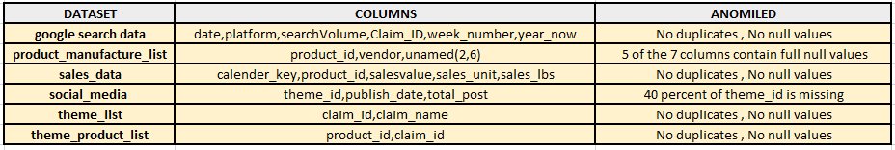
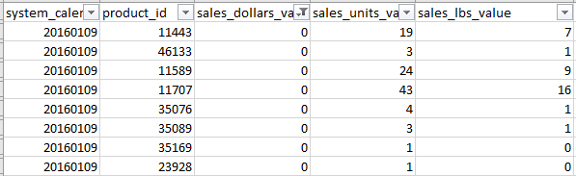
EDA
P
Under the Sales_data Sales Dollar value are 0. But, their are associated unit value. So, that we have considered as a Outlier.

Slide 4
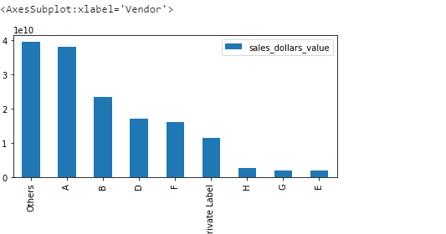
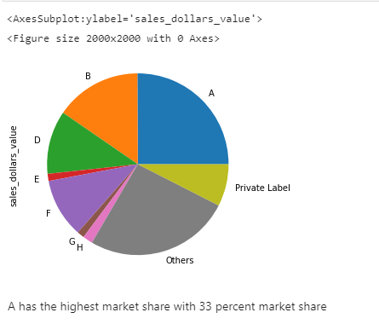
Overall market share of client
Overall market share of A = 33.47 %

Slide 5
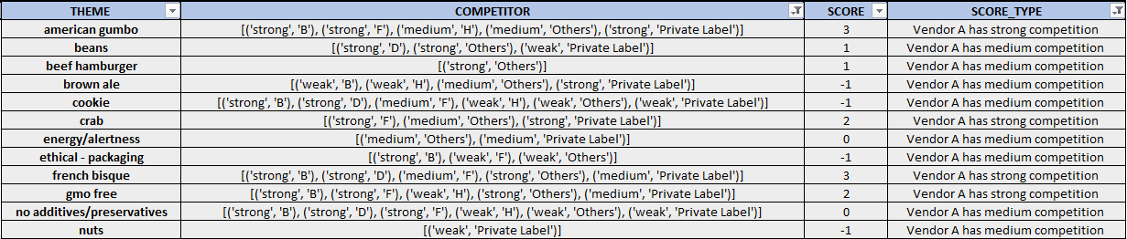
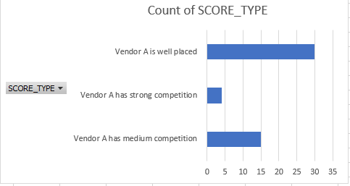
Competition for client in each theme
From the above competitor list and their respective total sales we are able to evaluate how well our client is placed among other brands,
THEME : Name of the Theme
COMPETITOR: A list of competitors and their level of competence relative to our Client A.
SCORE : A score generated according to the magnitude of competence of the THEME
SCORE_TYPE: Classification of competition Type w.r.t our Client A

Slide 6
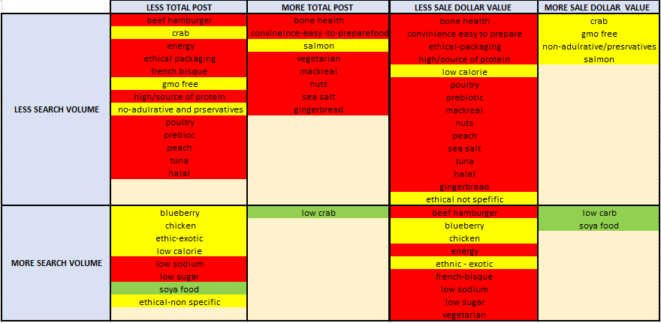
TREND B/W SOCIAL-SEARCH-SALES
RED TREND :
Less total post/More total post—-> Less Search Volume—->Less Sales Dollar Value
YELLOW TREND:
Less total post —-> Less Search Volume —-> More Sales Dollar Value
More total post —->Less Search Volume—-> More Sales Dollar Value
Less total post —-> More search Volume—-> Less Sales Dollar Value
GREEN TREND :
Less total post/More total post —-> More Search Volume—->More Sales Dollar Value
Search Volume having much more impact on the Sales Dollar Value
H0: rho=0 || H1: rho !=0 PEARSON CORRELATION TEST
Search Volume Vs Sales Dollar Value || rho= 0.24 || rho !=0 || Reject H0
Total Post Vs Sales Dollar Value || rho= 0.16 || rho !=0 || Reject H0
As, rho value for Search Volume w.r.t Sales dollar value is more as compare Total Post w.r.t Sales Dollar Value

Slide 7
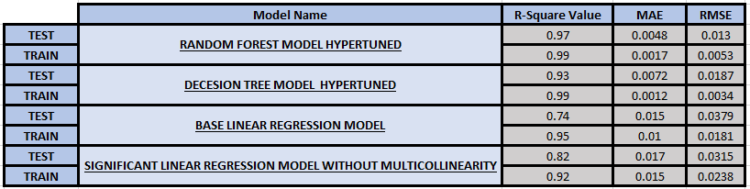
MODELLING
Aggregated Dependent Variable Sales Dollar Value on the basis of Theme and Vendor
Used One Hot Encoder for Label Encoding and Scaled the Data using the MinMaxScaler.
MODEL 1: Base Linear Regression Model is overfitted with 21%
MODEL 2: Linear Regression Model with significant Features and without multicollinearity we are able to reduce the overfitting by 10%
MODEL 3: Decision Tree Regression Model with Hypertuned Parameter using the GRID Search CV. Through this overfitting model reduced to 6%
MODEL 4: Random Forest Regression Model with Hypertuned Parameter using the GRID Search CV. Through this overfitting model reduced to 2%
MODEL 2 is slightly overfitted model. But, it can explain feature impact on Target.
Whereas, MODEL 4 can be use for prediction as it is having good score

Slide 8
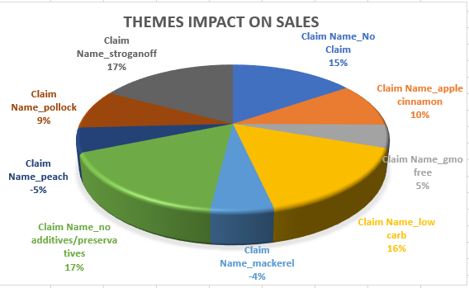
CONCLUSIONS
Themes with high business opportunity
Non additives/preservatives, Stroganoff and Low Carb themes having significant high business opportunity
Apple cinnamon, Pollock and gmo free having slightly low business opportunity
Peach and Mackerel Theme having negative business opportunity

Slide 9
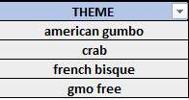
Factors to increase sales across themes
Themes where client A has strong competition ( themes given in image below) should be given more attention. Product quality and product price needs to be looked into in these themes
In the other themes , the existing business plan should be executed with more accuracy as there is evidence that it works in the form of good sales w.r.t other brands.

Slide 10
5% increase in sales overall
The only way we can increase the sales is either increasing the price, increasing the products in various themes or increasing the production.
By, analysing the trend we can see that themes which is following more total post —> less sales dollar value can be targeted with strategic marketing
From, the above slides we can say that where Client A is having the medium competition. Client can Target that particular Theme Products.

Slide 11

THANKS
Please keep this slide for attribution

